Slide 1
Network Security with Geo-location
Using geo-location as a part of an authentication scheme
Fan Zhang, Zhiqi Chen 12/11/2012
Notes:
Hello everyone, my name is Fan Zhang, and she is Zhiqi Chen. Our project is network security with geo-location, in other words, using geo-location as a part of an authentication scheme.

Slide 2
Overview
Introduction
Problem Motivation
Problem Statement
Challenges
Solutions
Result
Related Work
Validation
Revision
Future work
Notes:
This is the outline for our presentation.

Slide 3
Introduction
Geo-location will be used as a part of authentication scheme
Geo-location + Password/Username
Objective: Enhance network security
Notes:
Geo-location has the ability to determine where is the user’s physical location. We want to combine geo-location as a part of authentication scheme. That is to combine user’s physical location with passwrod/username. The objective for our project is to reduce internet frauds and hacker attacks, so that increase Internet security.

Slide 4


Problem Motivation
Internet frauds
Hacker attacks
Password cracking
Spoofing attack (Phishing)
User authentication
Username/Password
Some websites may add other techniques
(confirmation email, IP address, MAC address)
Notes:
Today, tons of internet frauds and hacker attacks happened everyday and everywhere. It makes the Internet more and more unsafe, untrusted, and unreliable. If we just google the internet frauds, we will surprised by finding out there are a lot of different ways of internet fraud, and the fraud can happened in chart room, email, message board, or on website. Luckily, many of the internet frauds and hacker attacks can be avoid if properly techniques apply. For most website, the user authentication is username plus password. Some websites may add other techniques like sending confirmation email, check IP address, check MAC address.

Slide 5
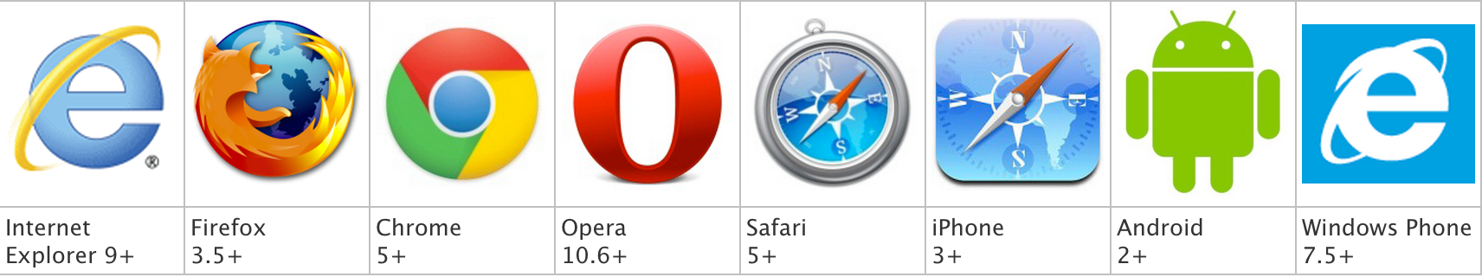
Problem Motivation
HTML 5: Geo-location
Common sources of location information
Global Positioning System (GPS)
WiFi
IP address
Browser support
Notes:
With the development of HTML5, it providing native support for locating browsers and GPS-enabled phones
GPS is the most accurate way to determine positioning, but it’s less energy efficient than other options and sometimes requires a lengthy startup time.
Mobile devices that support Wi-Fi access points can use hotspots to determine the user’s location.
Stationary computers without wireless devices can obtain rough location information using known IP address ranges.

Slide 6
Related works
Localizing the Internet: Implications of and Challenges in Geo-locating Everything Digital
Michael R. Evans and Chintan Patel
University of Minnesota Computer Science and Engineering
“Technology that allowed for universal authentication and location-determination services for permitted parties would allow a person to restrict online banking access to their own homes, or a government entity to require that classified information be accessed within pre-determined spatial boundaries. “
Notes:
Our project is inspired by a paper written by Michael Evans and Chintan Patel from Univeristy of Minnesota computer science and engineering department. In their paper, they point out that “Technology that allowed …”

Slide 7
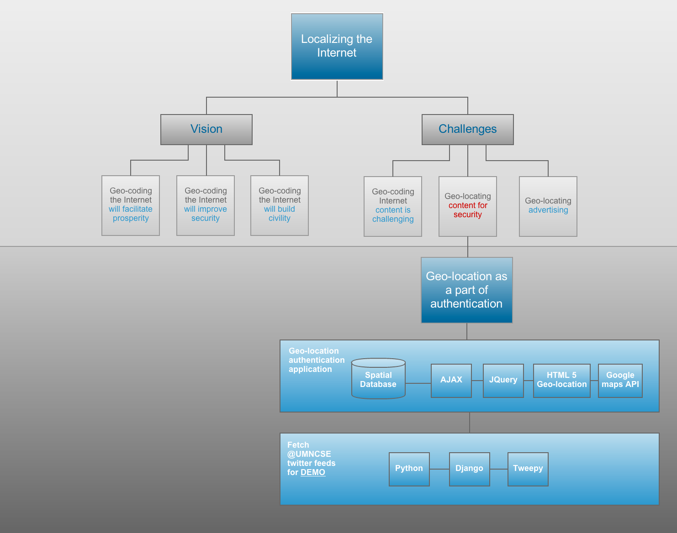
Related works
Main limitation: Only conceptual knowledge, NO implementation
Our project presents Implementation details
Notes:
In their paper, they introduced vision and challenges for geo-coded Internet. For vision and challenges, they both talked about in details from three different aspects. However, the main limitation in their paper is they only introduced the conceptual knowledge, no implementation details covered. Our project is going to implement one challenge in their paper: Geo-locating content for security. We are going to make the Geo-location authentication as a part of authentication scheme. Our project combines by two parts, first parts is Geo-location authentication application, the second part is a web application that fetch @UMNCSE department twitter feeds, and it will be used for demo purpose.

Slide 8
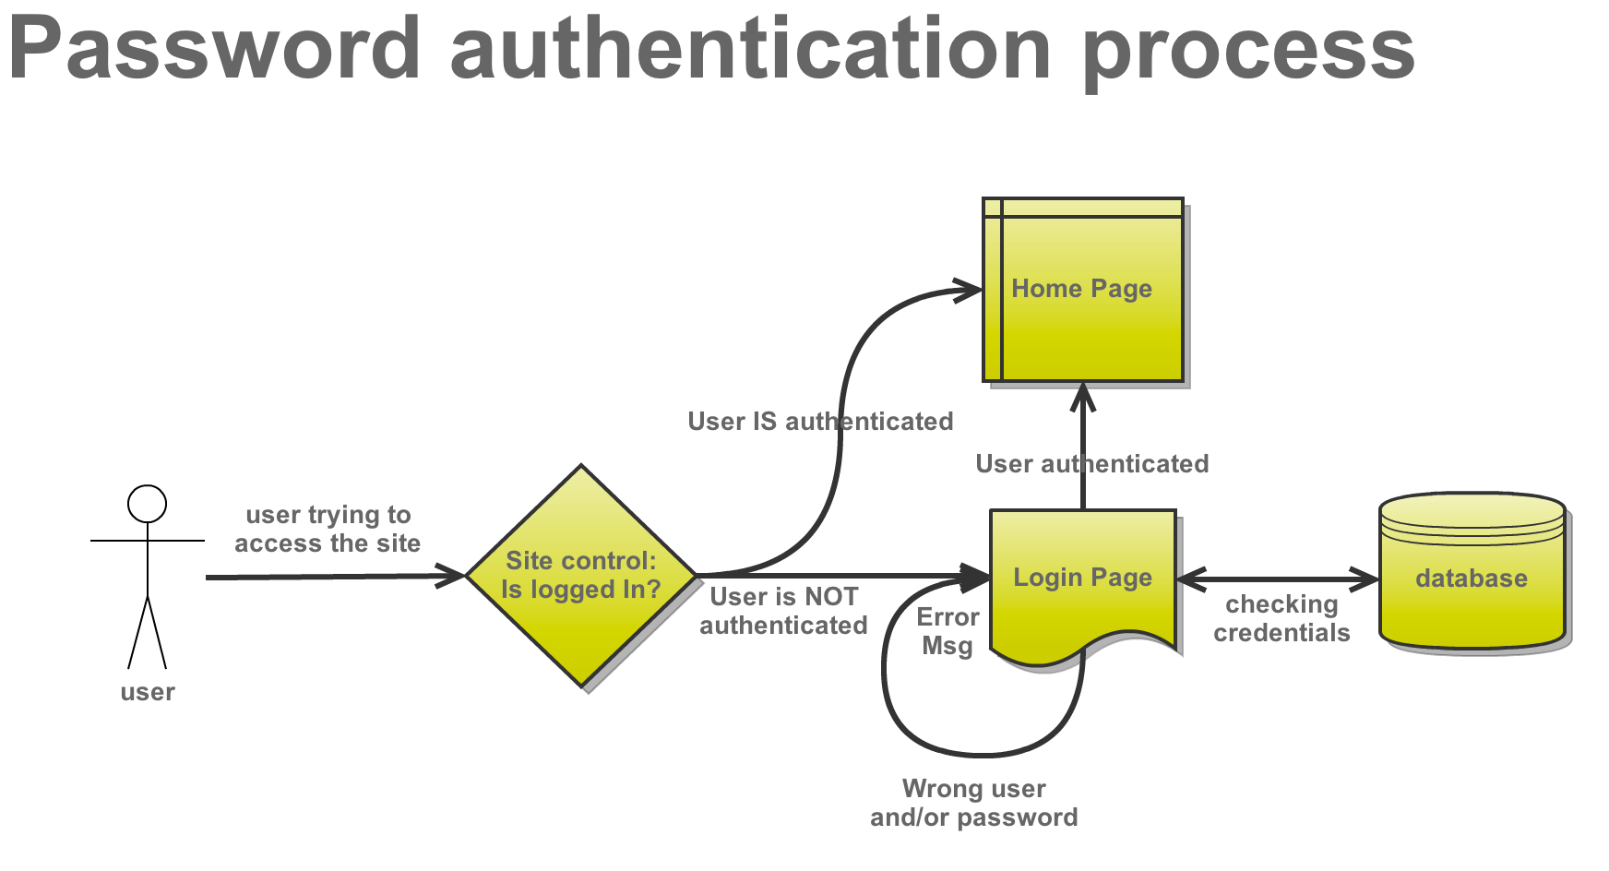
Problem Statement
Normal User Authentication
Notes:
In problem statement, let’s take a look at normal user authentication process. First when the user trying to access the site, the decision will be made whether the user is logged in or not, …

Slide 9

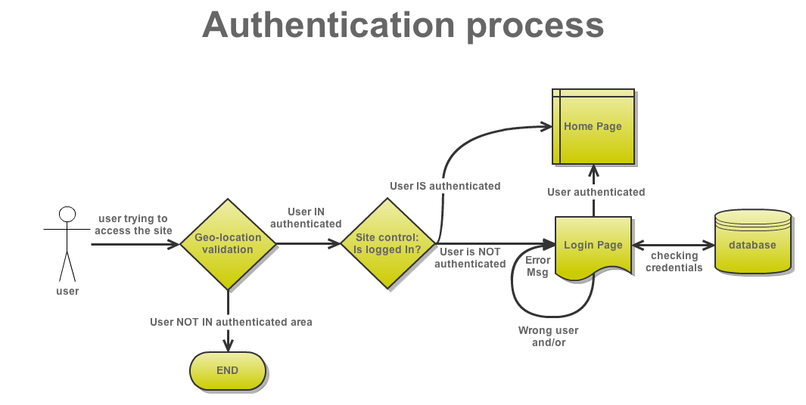
Problem statement
Hacker
Authentication with Geo-location
Notes:
Let’s take a look at Geo-location authentication process, we just modified the very beginning of the normal authentication process by adding a decision unit of Geo-location validation. If the user is not in the authenticated area, the authentication process ends. If the user is inside of the authenticated area, then the user will be forward to normal authentication process.

Slide 10
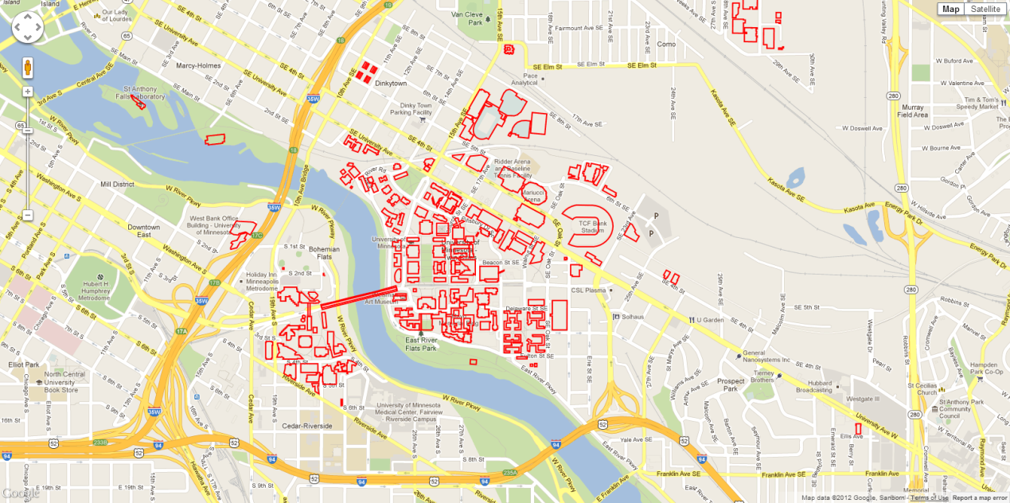
Challenges
Fetch each building’s shapefile
Each building’s shapefile save as a KML file
KmlLayer can’t be modified after render out
Can’t obtain coordinates from KmlLayer
The figure shows the KmlLayer render out on Google maps

Slide 11
Challenges
Find functions to determine whether a location is inside a polygon or not
Limited functions for KmlLayer in Google maps API

Slide 12
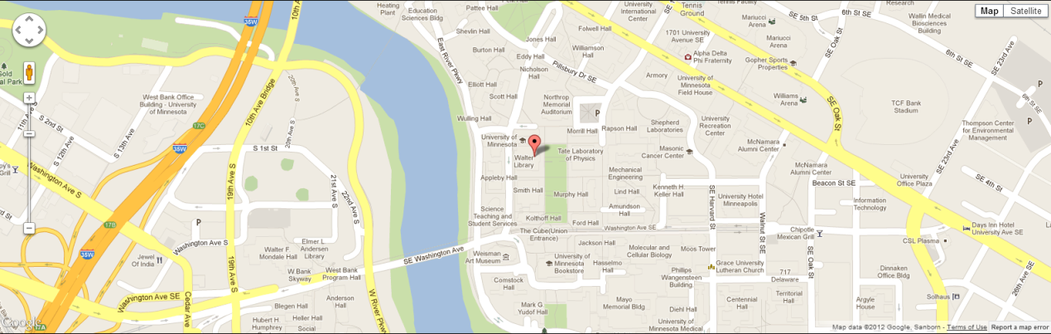
Solutions
Implement Geo-location with HTML 5 to locate user’s location
Use google.maps.Polygon instead of KmlLayer
More functions support

Slide 13
Solutions
Export shapefile into KML file
Extract building’s coordinates from KML file
AJAX: load KML file
Jquery: find the coordinates for the building and create polygon use the coordinates.
google.maps.geometry library: google.maps.geometry.poly.containsLocation(point:LatLng, polygon:Polygon)

Slide 14
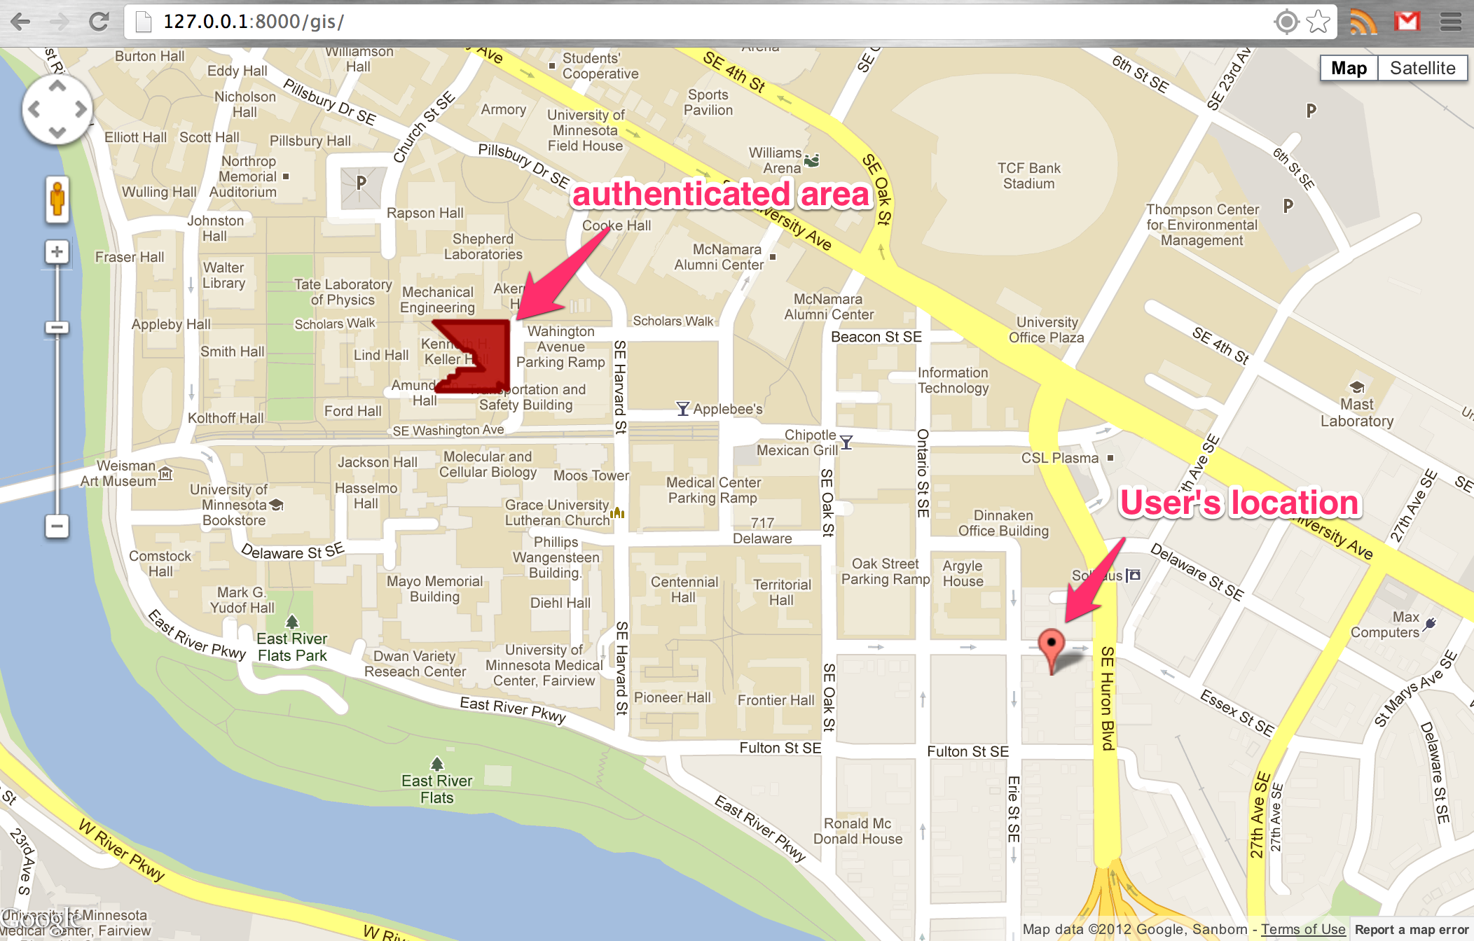
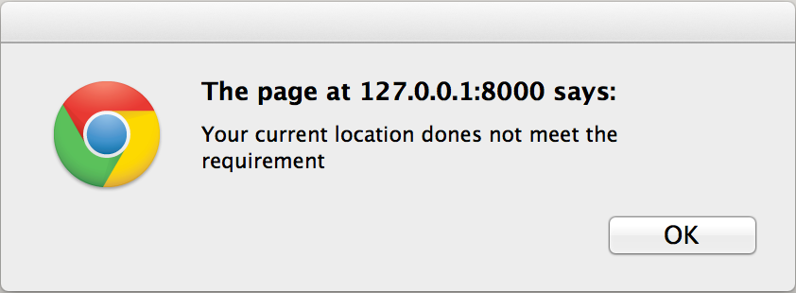
Solutions
User NOT IN the authenticated area
Alter window popup, user will not be forwarded
Authenticated area: Kenneth H. Keller Hall

Slide 15
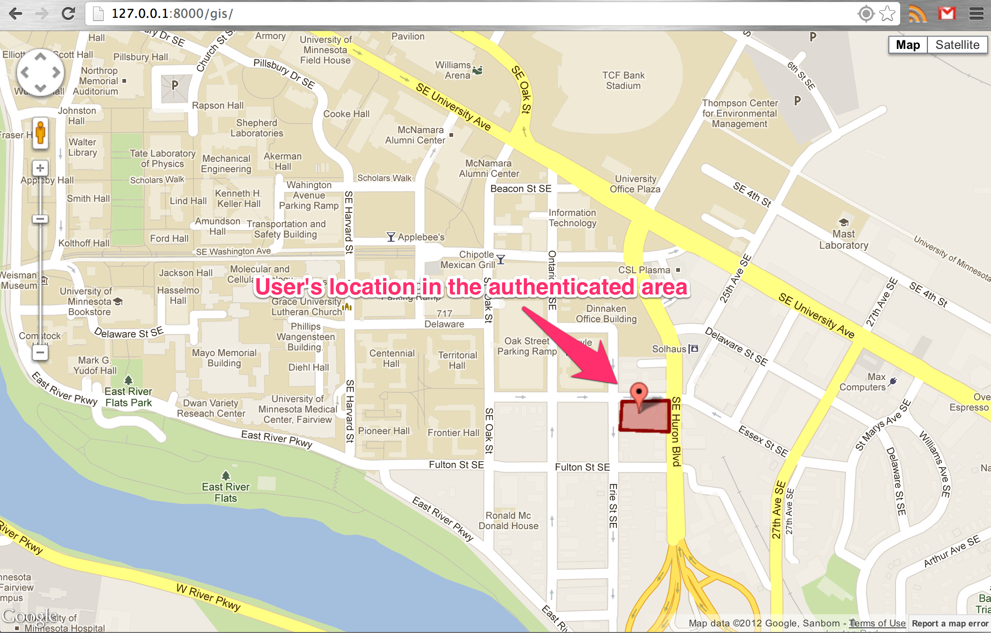
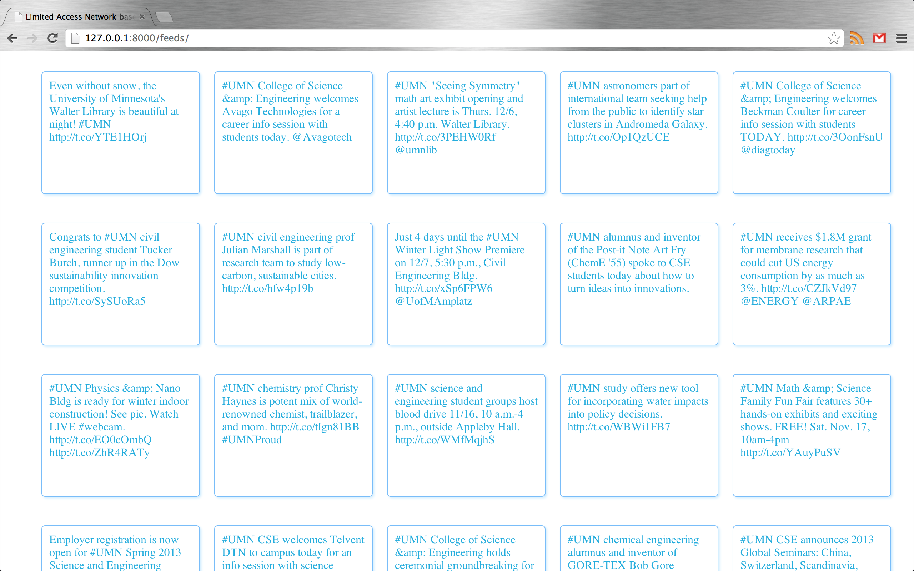
Solutions
User IN the authenticated area
Set a time delay to see the map
After authentication, forward user to home page
For demonstration purpose, the webpage fetch @UMNCSE twitter feeds
Python
Django
Tweepy

Slide 16
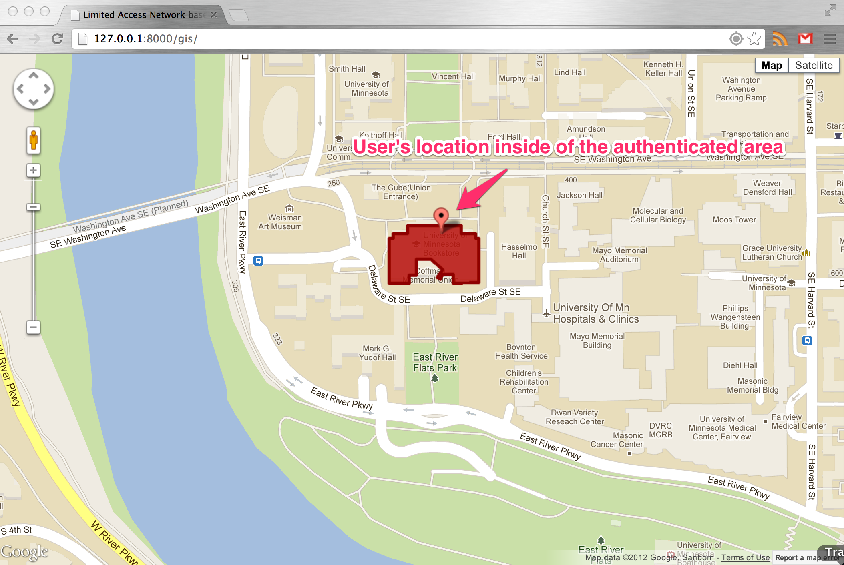
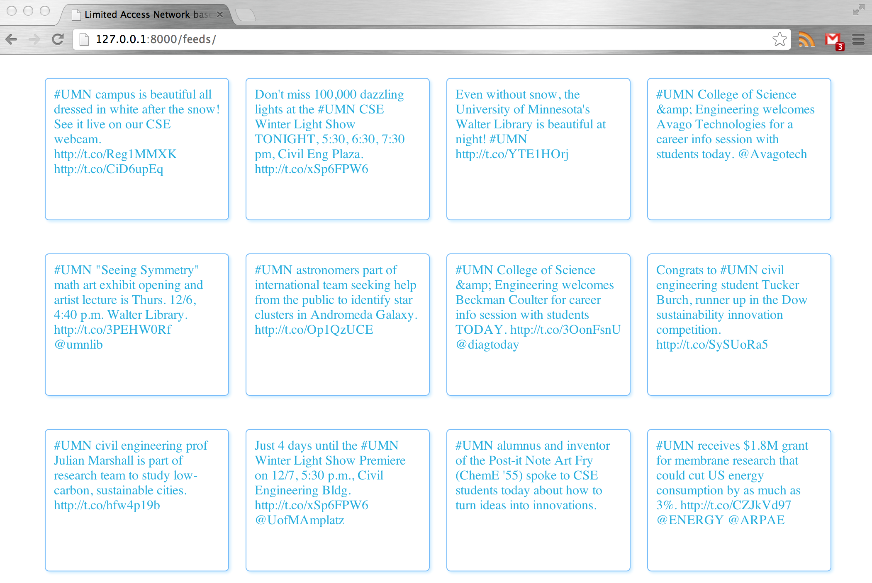
Validation
Coffman Memorial Union
Geo-location authentication success
Forward to the demo website

Slide 17
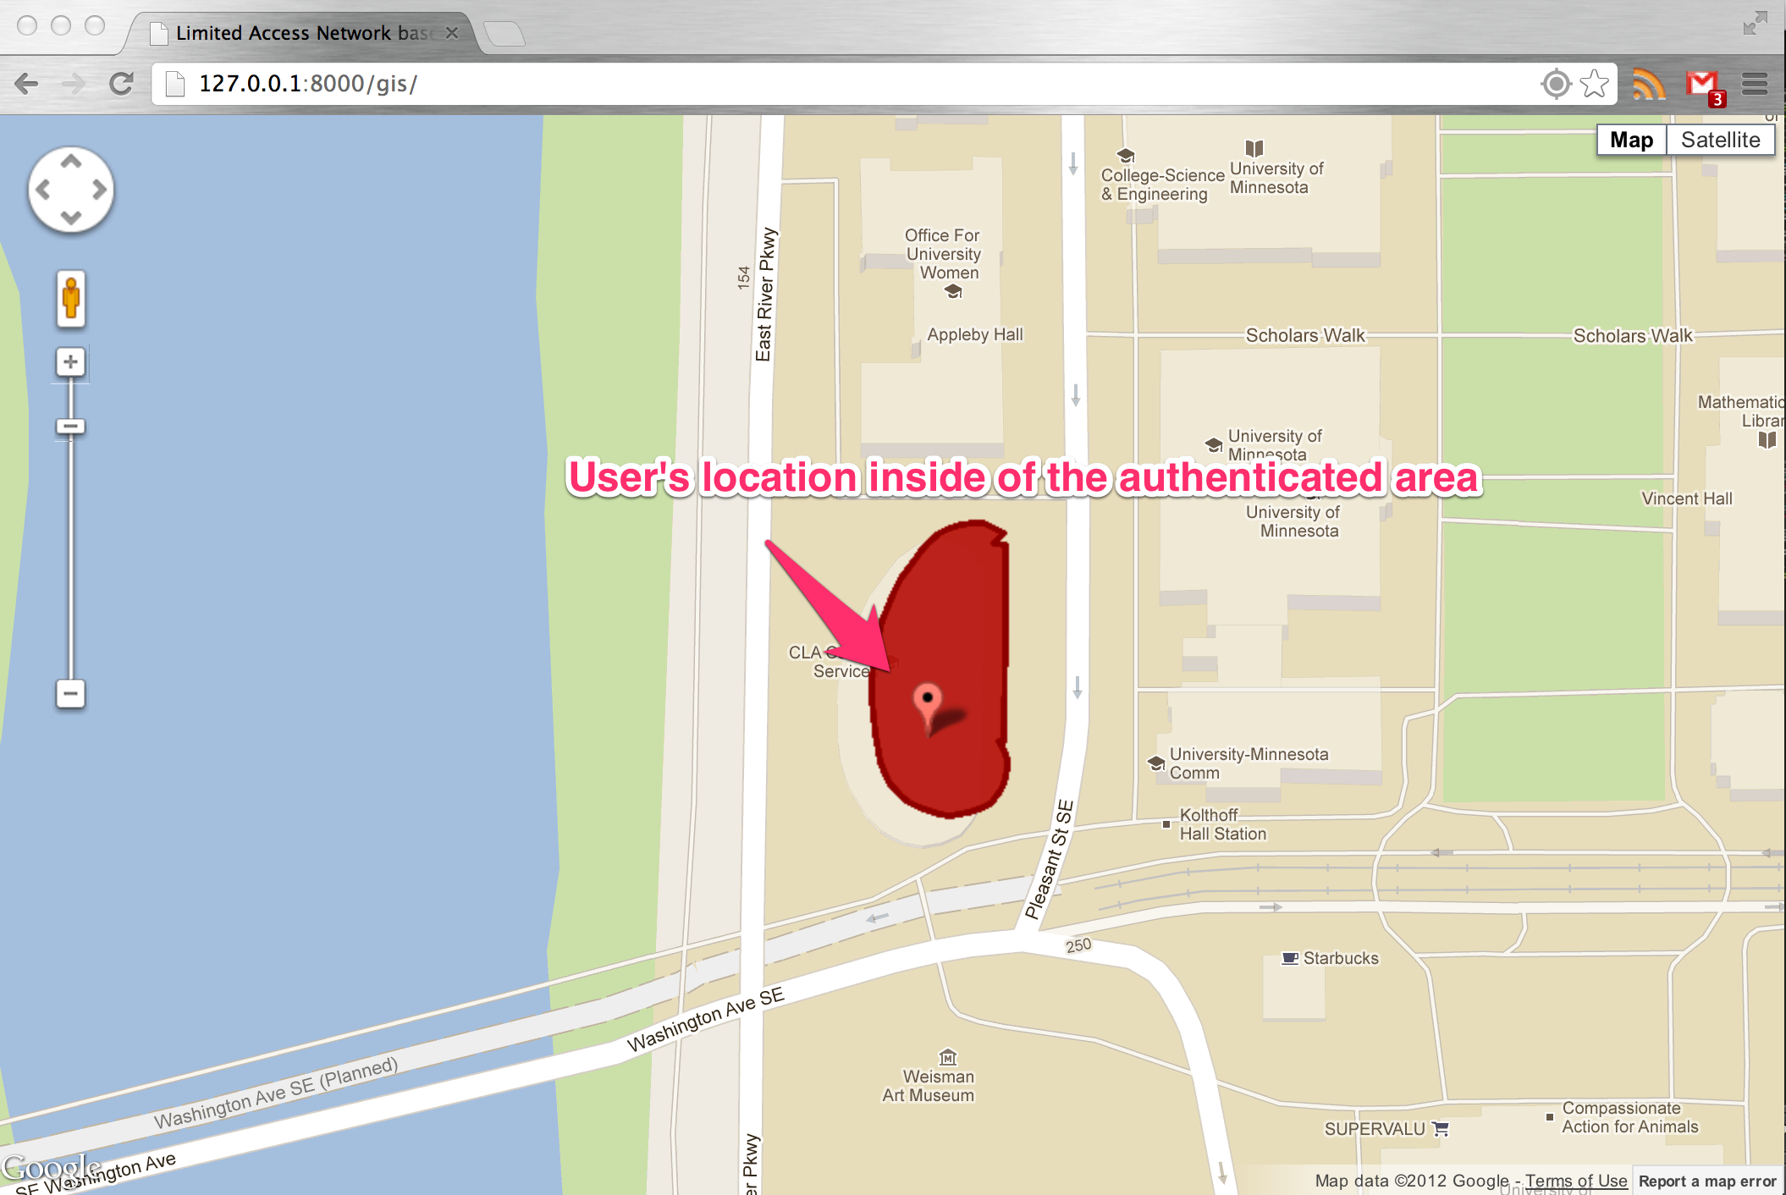
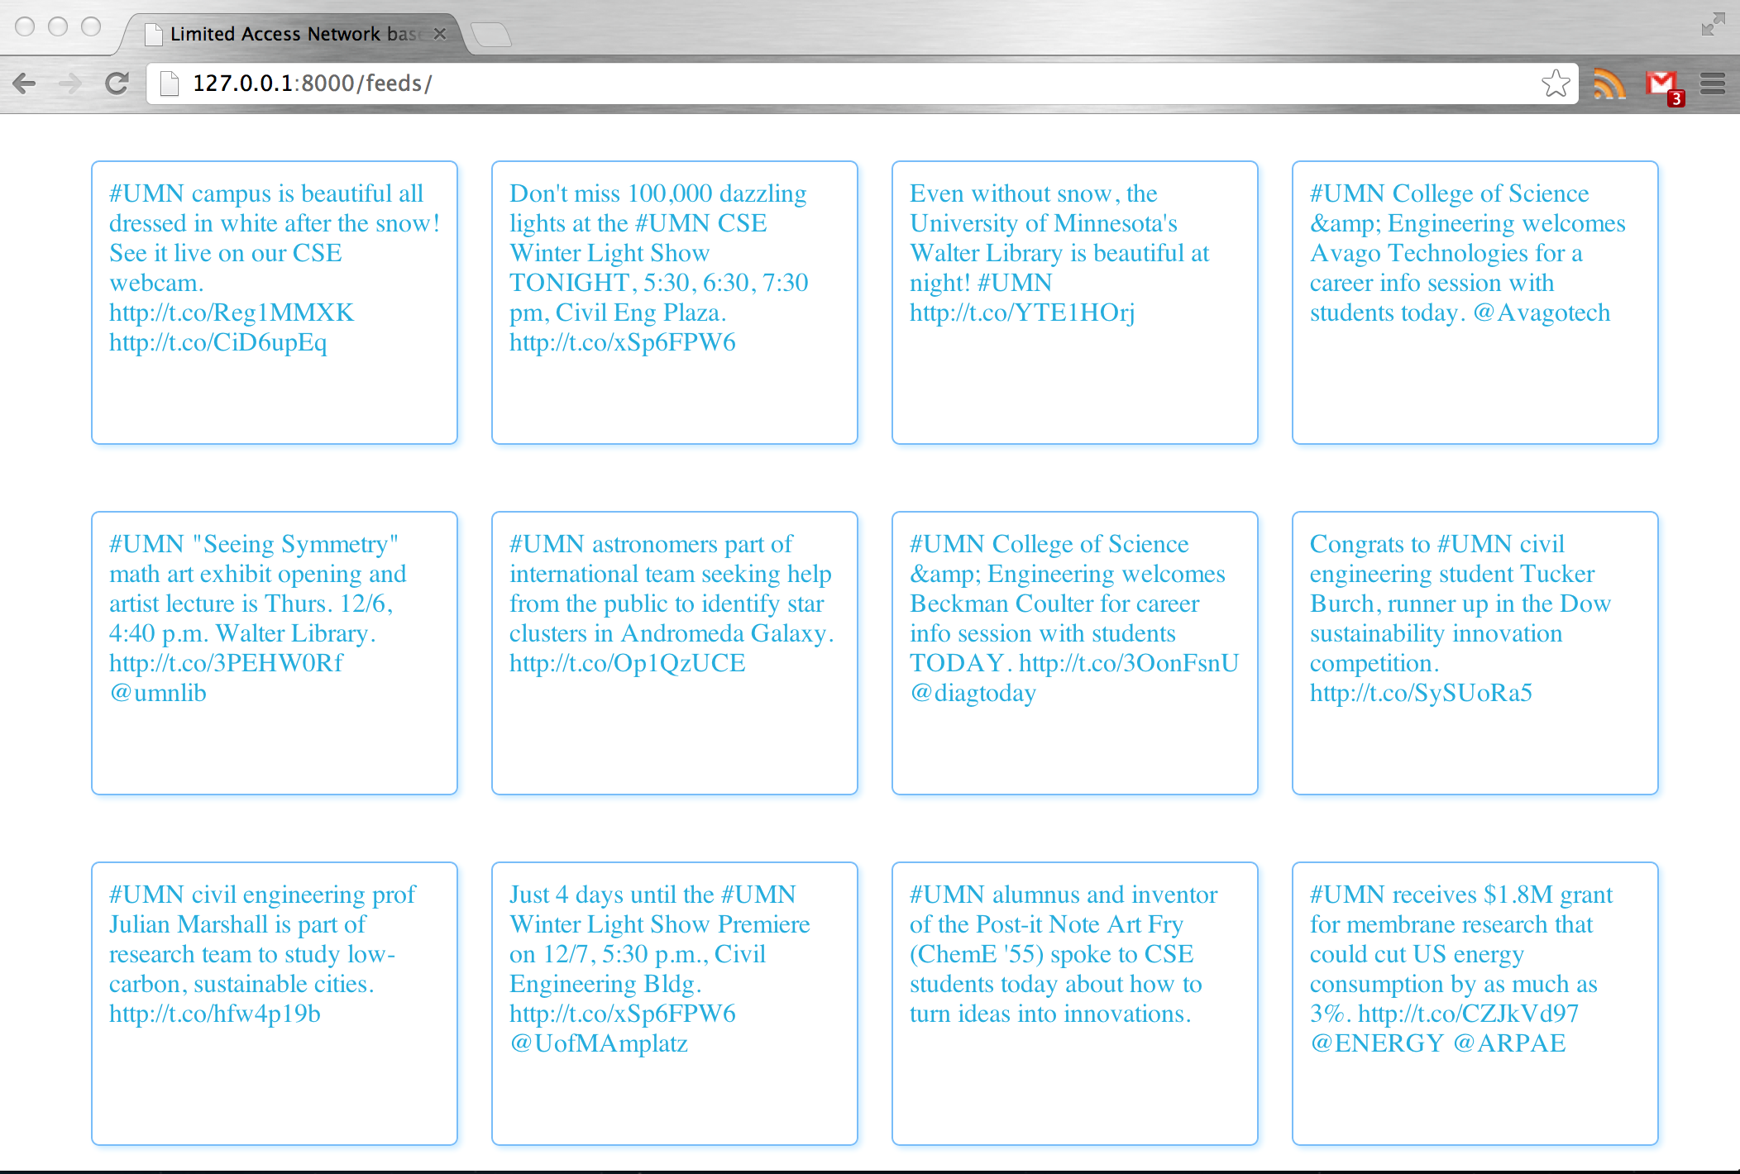
Validation
Student Teaching & Student Service
Geo-location authentication success
Forward to the demo website

Slide 18
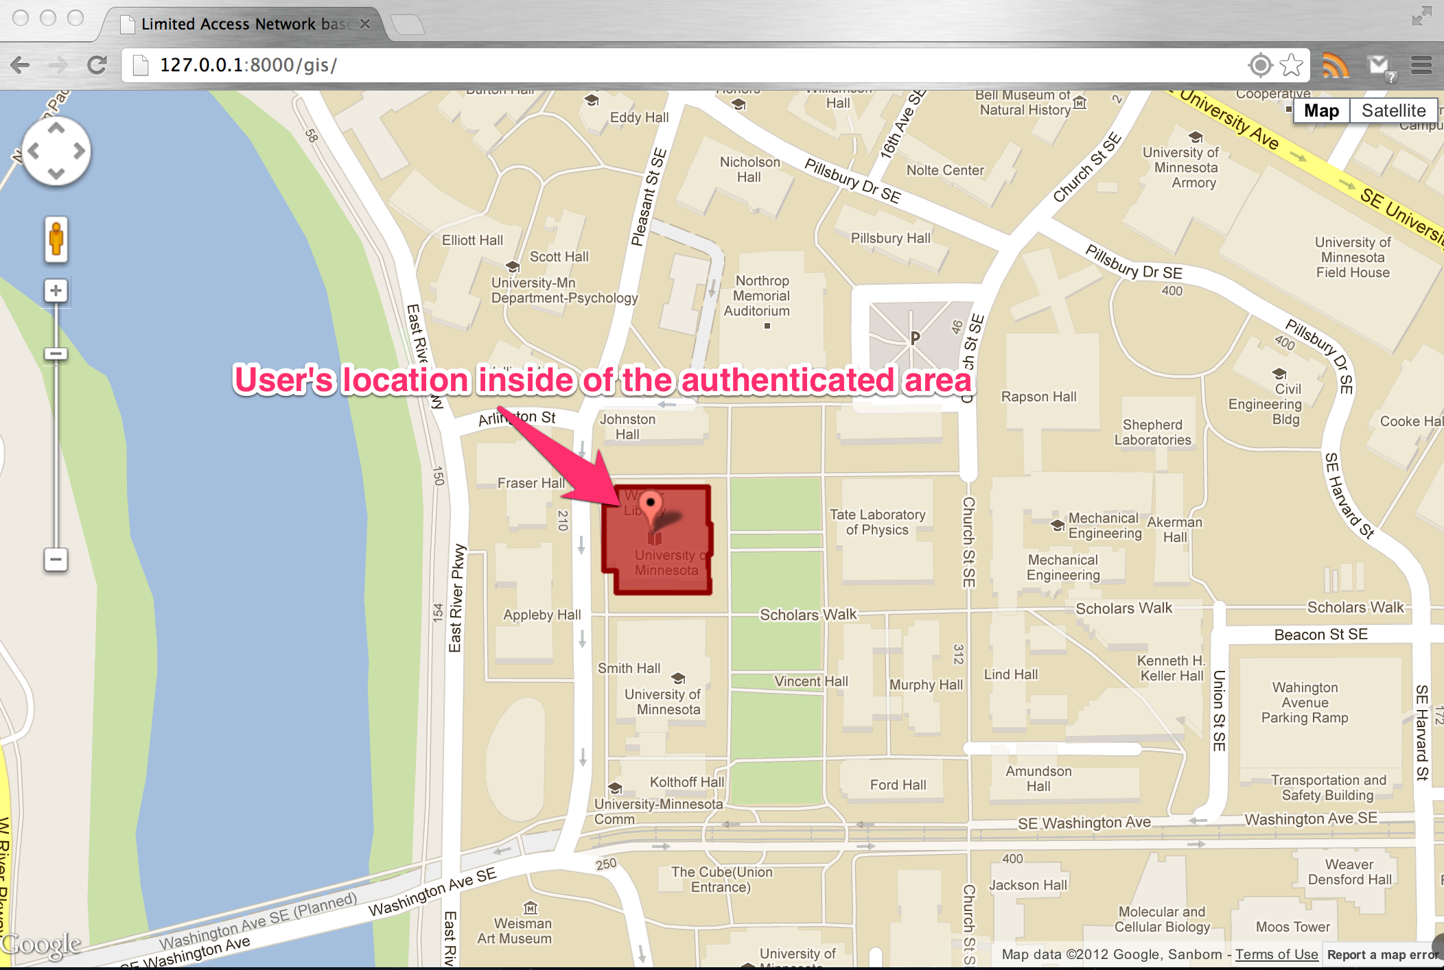
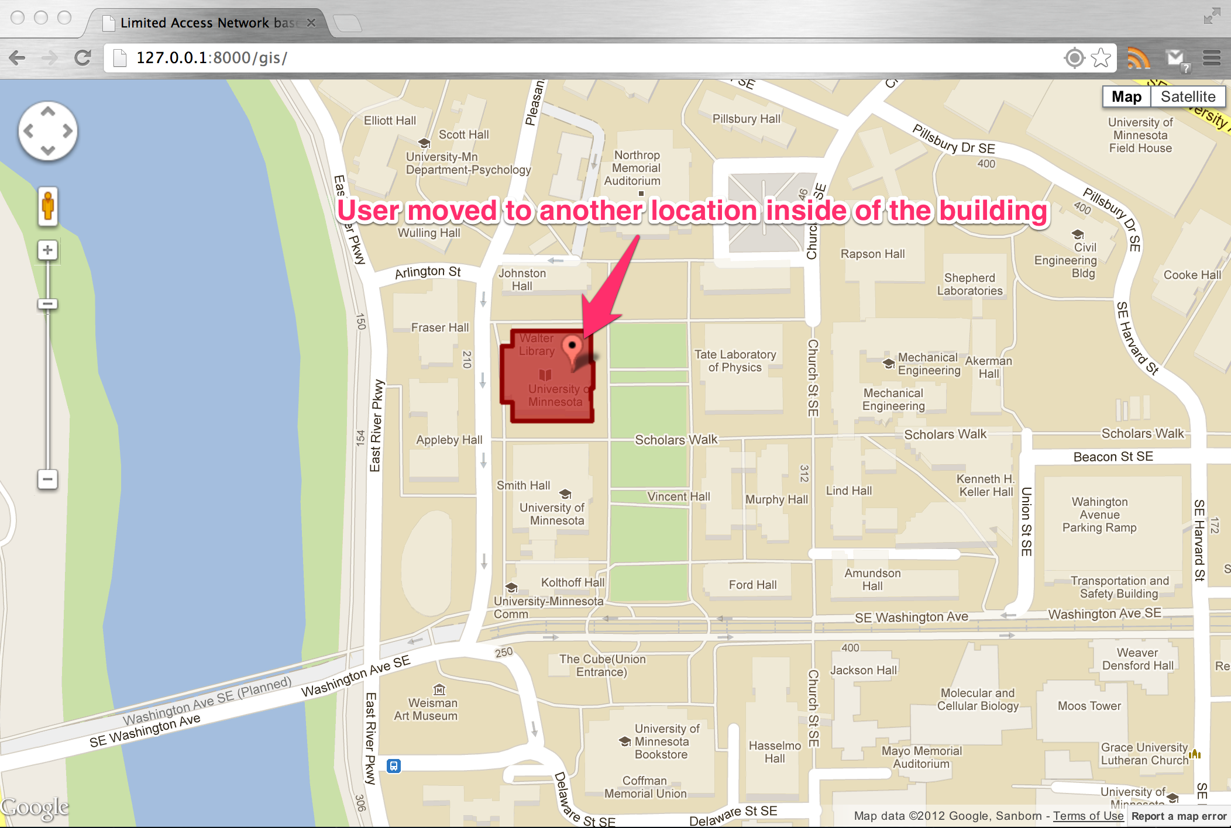
Validation
Walter library
Geo-location authentication success
Forward to the demo website
User moved to another location inside of the building
Geo-location authentication success
Forward to the demo website

Slide 19
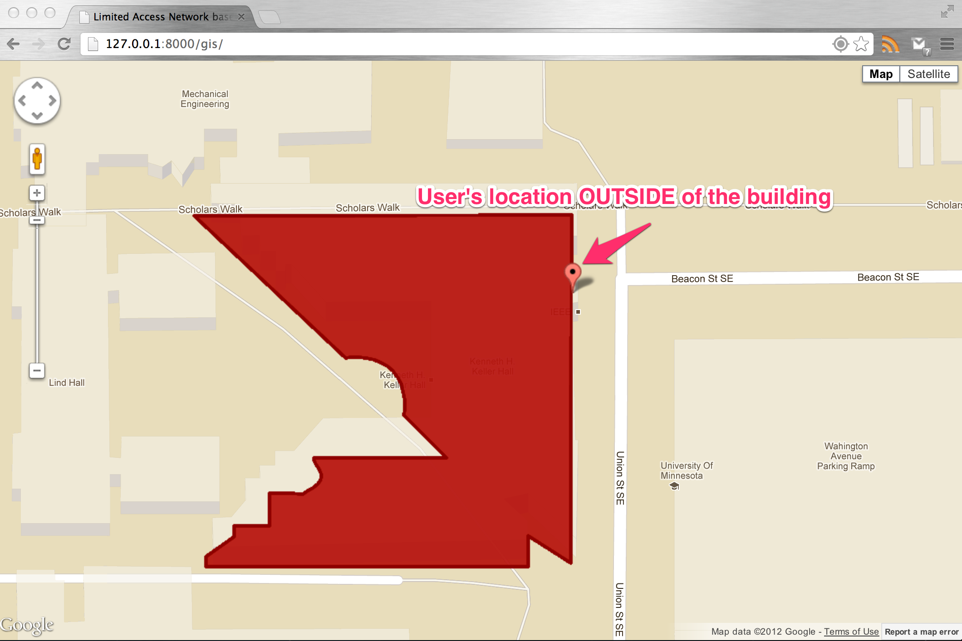
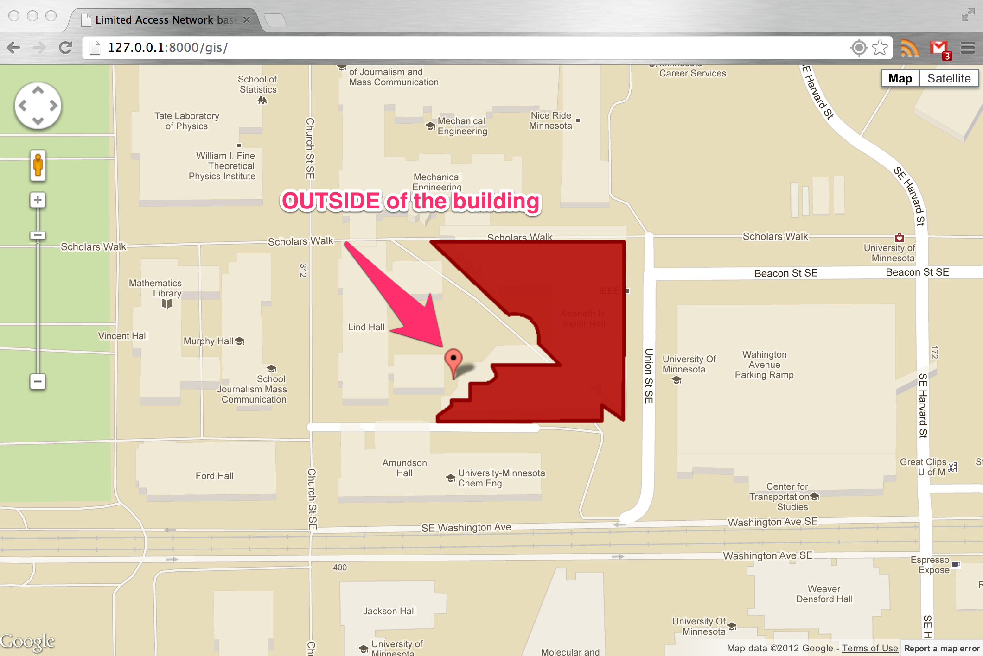
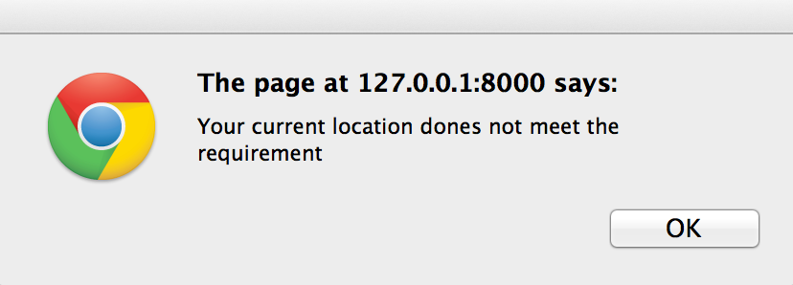
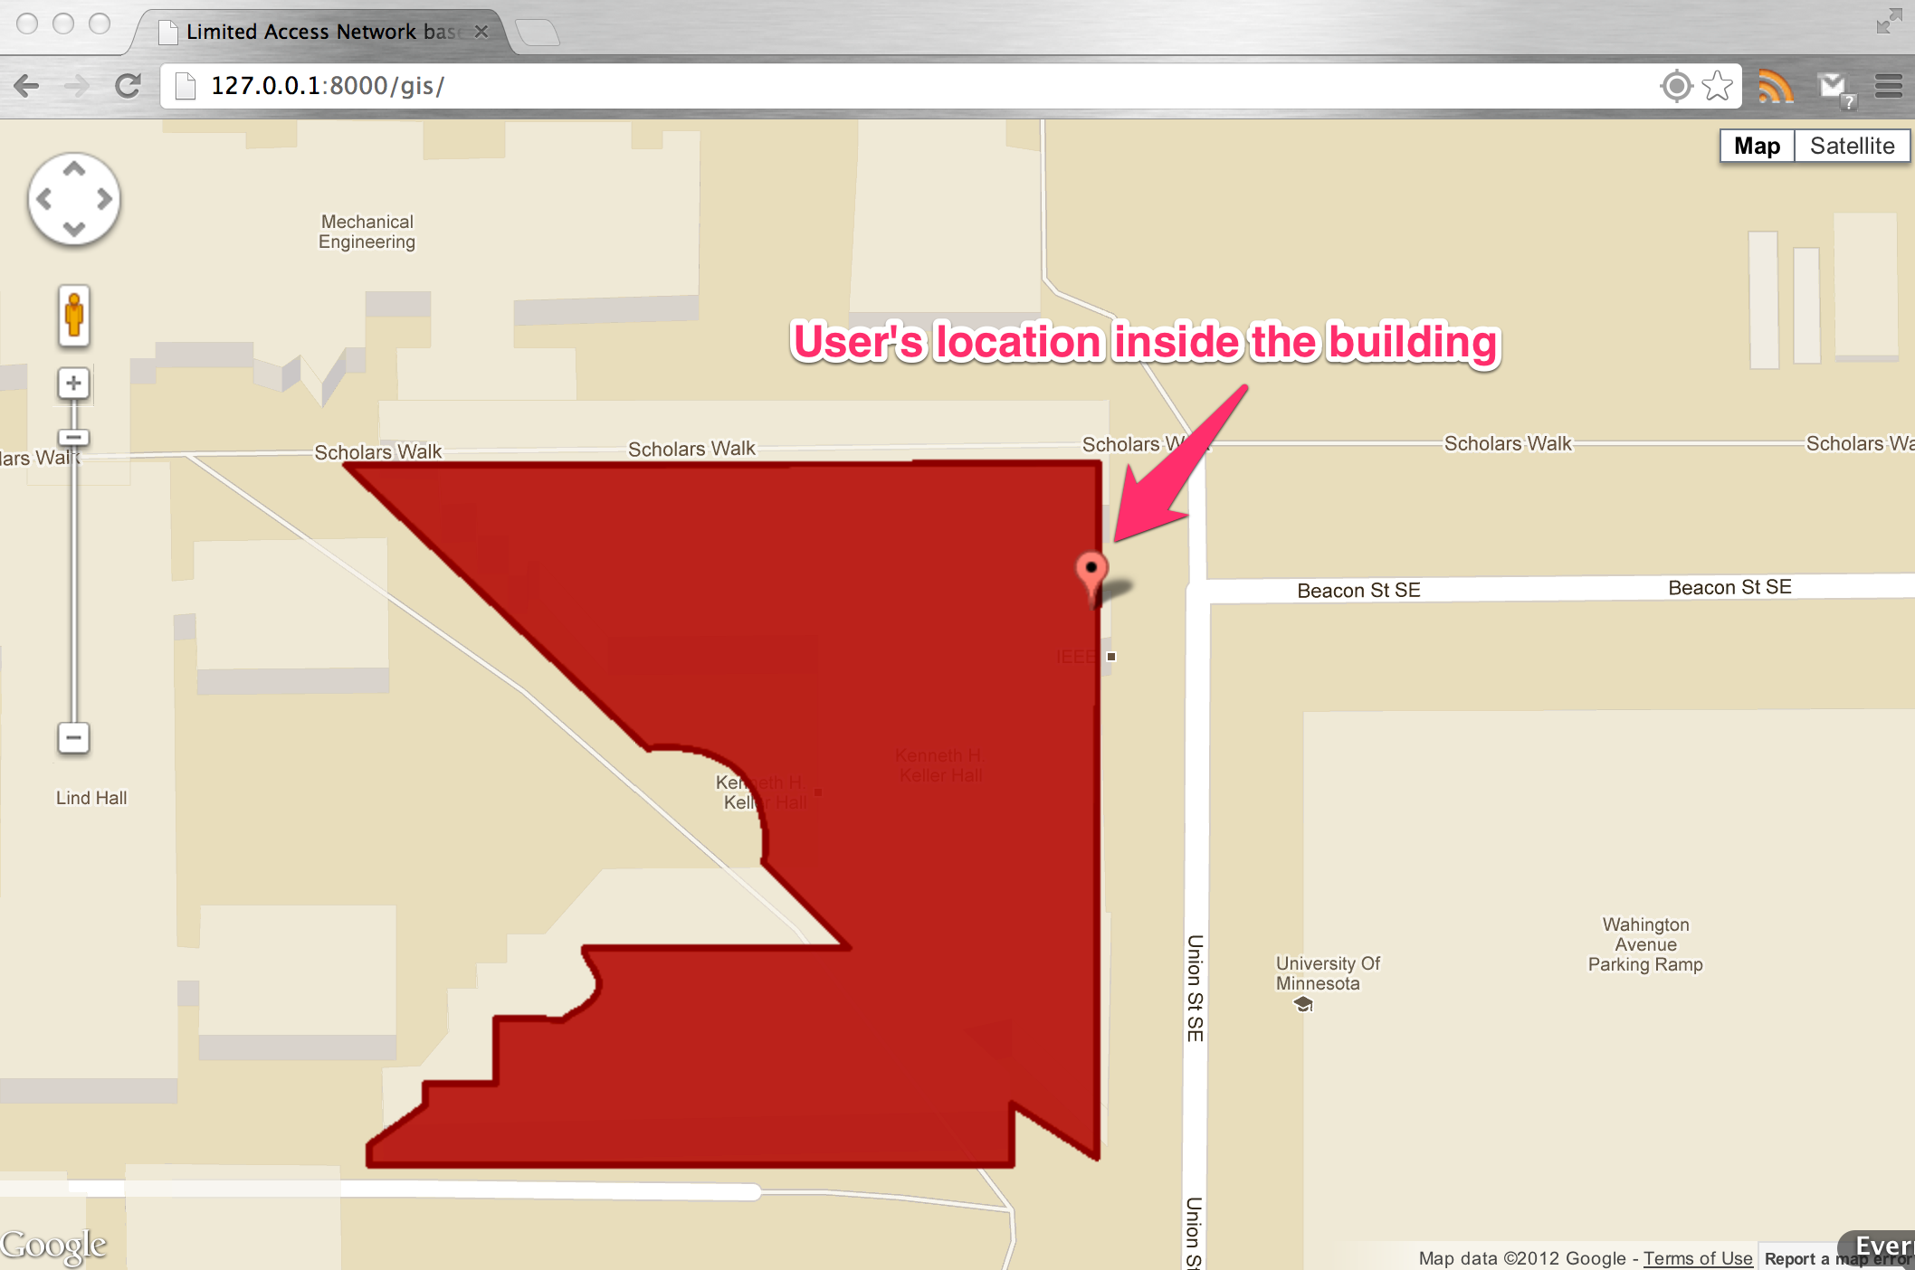
Validation
Kenneth H. Keller Hall
User moved to three different locations inside of the building
Top left: computer lab
Top right: KH 3-230
Bottom left: grand lounge
Geo-location authentication failed
Alter window popup
Geo-location authentication success
Forward to the demo website

Slide 20
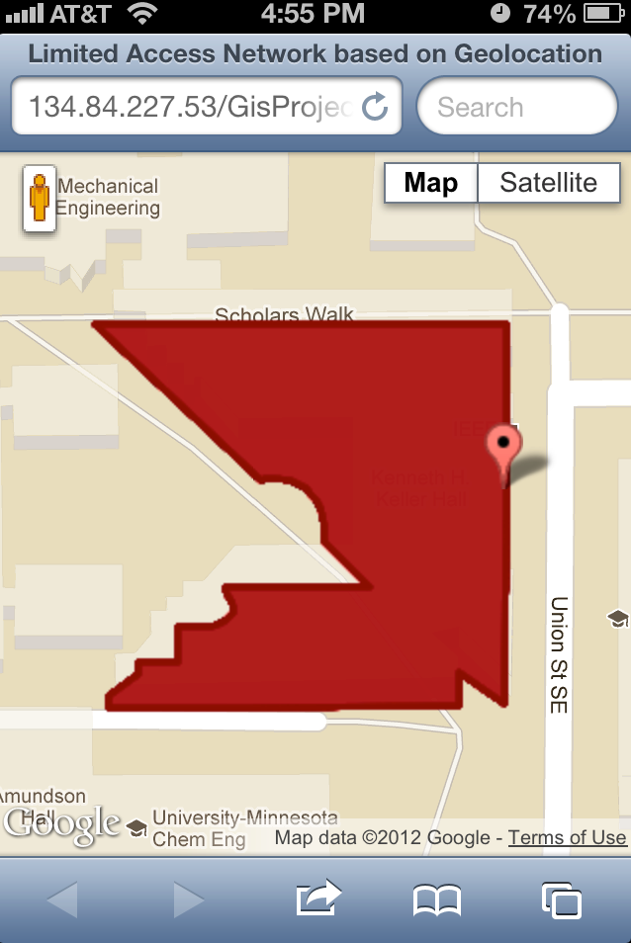
Validation
Kenneth H. Keller Hall
Cellphone GPS
User’s location: KHKH 3-125
Geo-location authentication success most of time

Slide 21
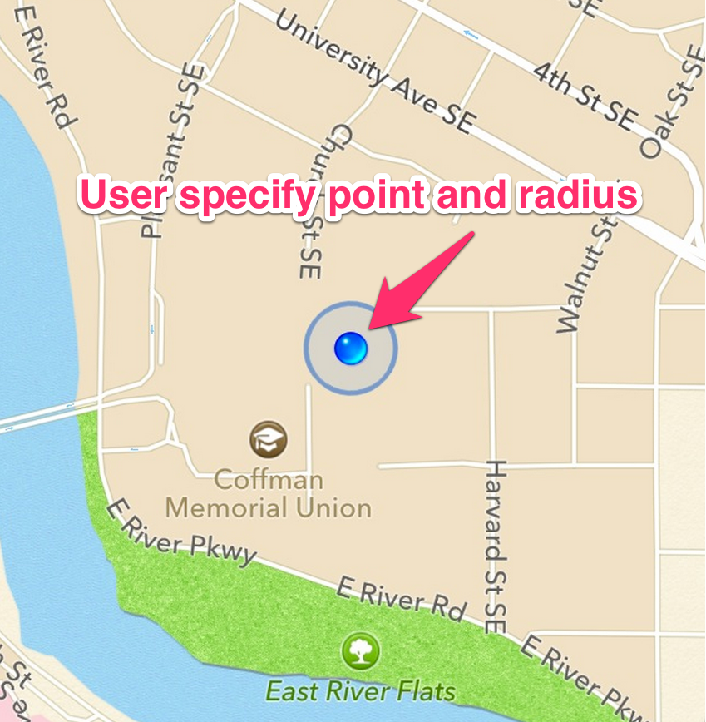
Revision(suggestions from group 8)
User specified a point with certain radius
Due to the inaccurate of Geo-location
Change the idea of the authenticated area from a building to a circle area
This update will give user more freedom to specify their favorite locations
No more need KML file

Slide 22
Revision(suggestions from group 8)
IP address lookup
In order to prevent the fake location login
IP address lookup could enhance the security of authentication process
Depend on the security requirements, use MAC address lookup could be more safe than IP address lookup

Slide 23
Future Work
Due to the Geo-location API not guarantee to return device’s actual location, the reliability of Geo-location authentication is not guaranteed.
Build multiple location support for geo-location authentication.
Welcome to folks me on GitHub
git://github.com/fanzhang312/FetchTwitterFeeds_Tweepy.git

Slide 24

Thanks Any questions?

